Slide 1
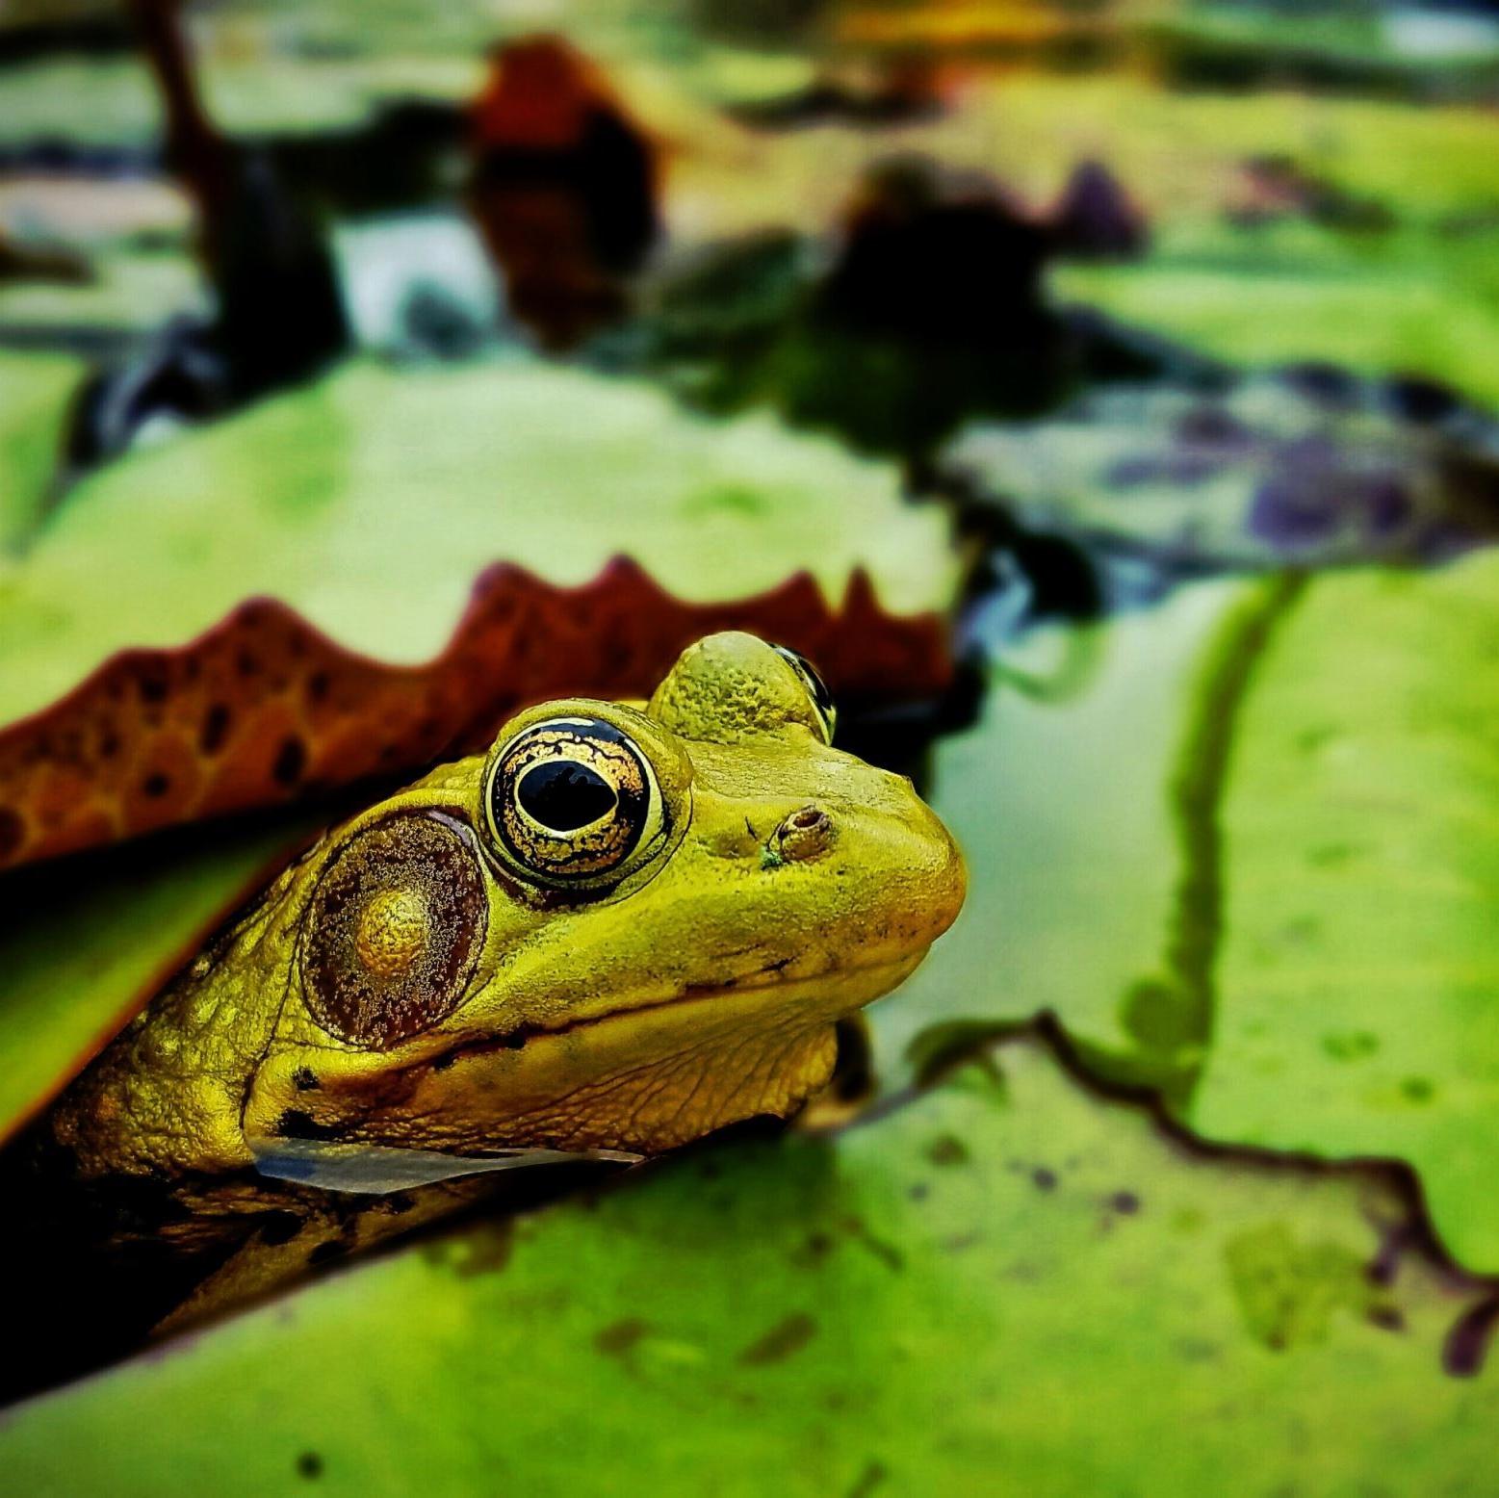
Frog's diary
LTT visit in Poland
6.06-10.06.2022

Slide 2
My school hosted guests from Turkey, Greece and Czech Republic.

Slide 3
First the children presented my mascot friends and talked about our features.

Slide 4
Next I showed the guests around the school.

Slide 5
The children could master their skills in ceramics. They did great!

Slide 6
They also played some integration games.

Slide 7
The next day we all went to Krakow. I saw a dragon for the first time in my life!

Slide 8
Then I jumped in a trampoline park. I was in heaven!

Slide 9
The next day we all went to the museum in Racibórz where children had an interactive lesson.

Slide 10
It was really interesting.

Slide 11
I learnt a lot about our culture and traditions.

Slide 12
The next day we continued with sport activities. I swam in the pool and I was the best!

Slide 13
In the afternoon we went bowling. It was hard to lift the bowling ball!

Slide 14
Finally, the children from all countries got the certificates.

Slide 15
It was a wonderful visit and unforgettable experience!

